Slide 1
Tools for Reader Investment and Immersive Fiction
Reinventing Fiction Craft from Philosophy
Presented by Molly Cernik

Slide 2

I’d like you to raise your arm
Image source
But not yet!
First, think about raising your arm. Imagine doing it.
  What does that feel like?
  For me, my arm feels like it is no longer in just one place, but all along the path I imagined.
Next, pay attention to when you decide to raise your arm, then raise it.
  When did you make the decision? When did you raise your arm?
  I always decide to raise my arm shortly after doing it.
  You can put your arm down ☺
Last, but not least: think about raising your arm again, but don’t do it.
  What does ‘not raising your arm’ feel like?
  I feel like I’m stopping or blocking myself.

Slide 3
Studying the self-evident
One name for this kind of exercise and reflection is “phenomenology.”
Basically, it’s a shared project to understand average, everyday experiences that are otherwise taken for granted.
  Practice this enough and you’ll start to perceive the workings of your own mind.
A lot of what I’m going to talk about is probably going to be pretty obvious in retrospect.
I promise I’ll get to fiction, but I need to set the ground first.
Well, yeah.

Slide 4
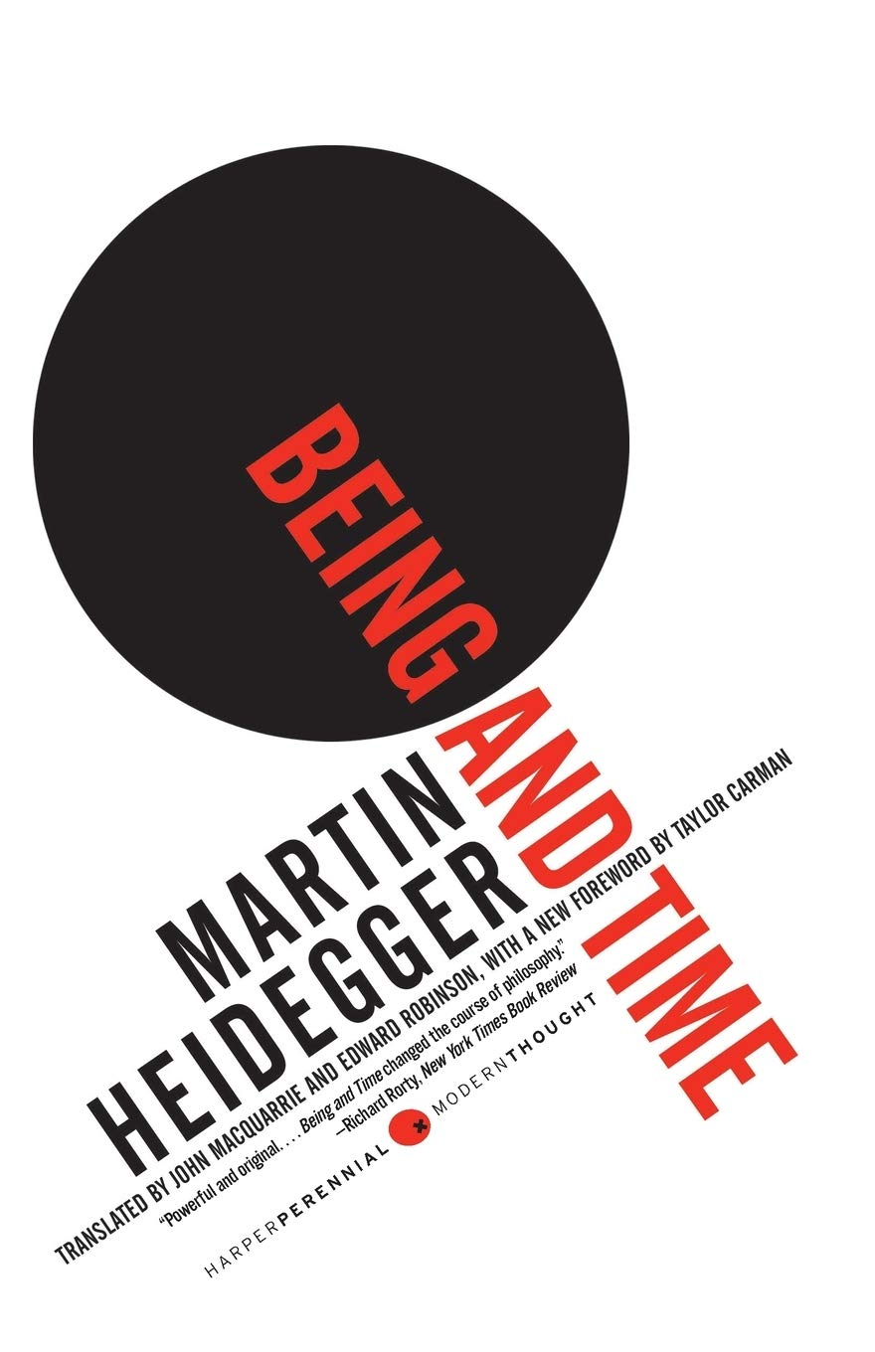


Important caveat
Most of what I’m talking about in this section comes from Martin Heidegger’s Being and Time, sometimes in nearly direct quotes.
This is an important book whose ideas have been used by people of many different political beliefs. However, it’s also important to take those ideas with a measure of criticism, because Martin Heidegger was the court philosopher for the Nazis.
I believe it’s possible to cut out the ideas from this book that have fascist implications; to me, this means ignoring what Heidegger has to say about death and ‘authenticity.’ I won’t be talking about either in this presentation.

Slide 5
Most important:
Consciousness starts with imagination

Slide 6

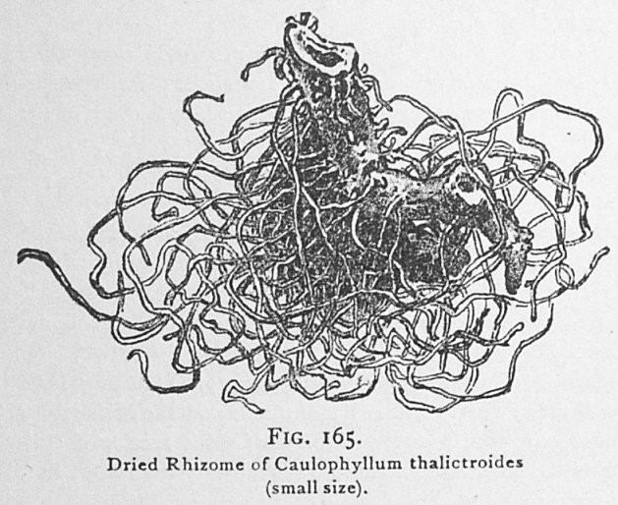
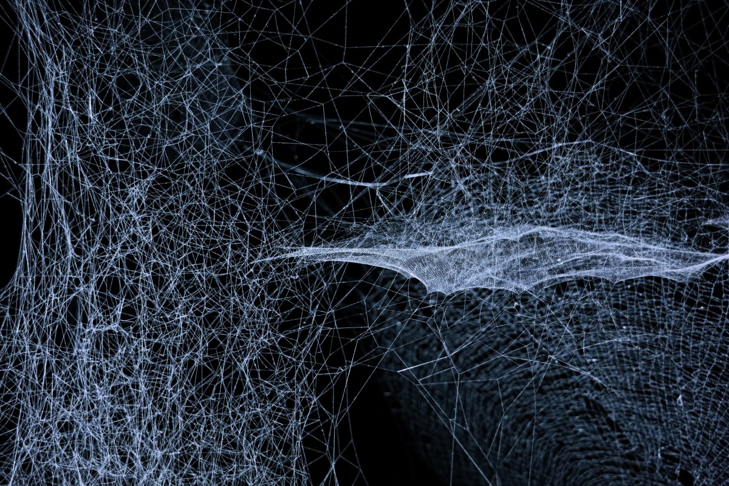

Imagination connects ideas
Imagination is an activity.
We connect things, objects, attributes, people, and stuff in our minds, and use those connections to imagine what we can do with the things we’ve connected.
  Simpler name: “entities”
Pertinent visual metaphors for imagination:
  Lightning
  Cobwebs
  Rhizomes
  Networks
Experience is about doing things
  ‘Doing’ happens first, then ‘being’ and ‘knowing’ come after.
Image source
Image source
Image source
Image source

Slide 7
Experience is about doing things
‘Doing’ happens first, then ‘being’ and ‘knowing’ come after.

Slide 8
Doing things is about caring
The essence of who you are is:
  the synergistic totality
    the gestalt (A.K.A. the vibe)
  of all the ways that you relate to the things around you
  and how you relate them to each other.
You are what you care about.
You are how you care about them.
You

Slide 9
What do we care about?
In the activity of the imagination, the natures of all entities are essentially equivalent:
  A television
  The colour blue
  The rising cost of housing
  My spouse
They are all entities that can be connected to each other to accomplish tasks.
“Meaning” is the capacity to affect action.
  Entities have meaning when they can be used to change the world.
Knowledge about something is always “how-to” knowledge:
  The ability to relate it to something else to accomplish a possible task.
  Even knowing “how someone’s hair looks” means knowing “how to look at their hair.”

Slide 10

Mind palace
The world we live in is mostly made up of these kinds of relationships and connections.
It changes along with the way we live in it.
It also both changes with our moods and promotes certain kinds of moods, based on the connections that are easiest to create.
Image source

Slide 11
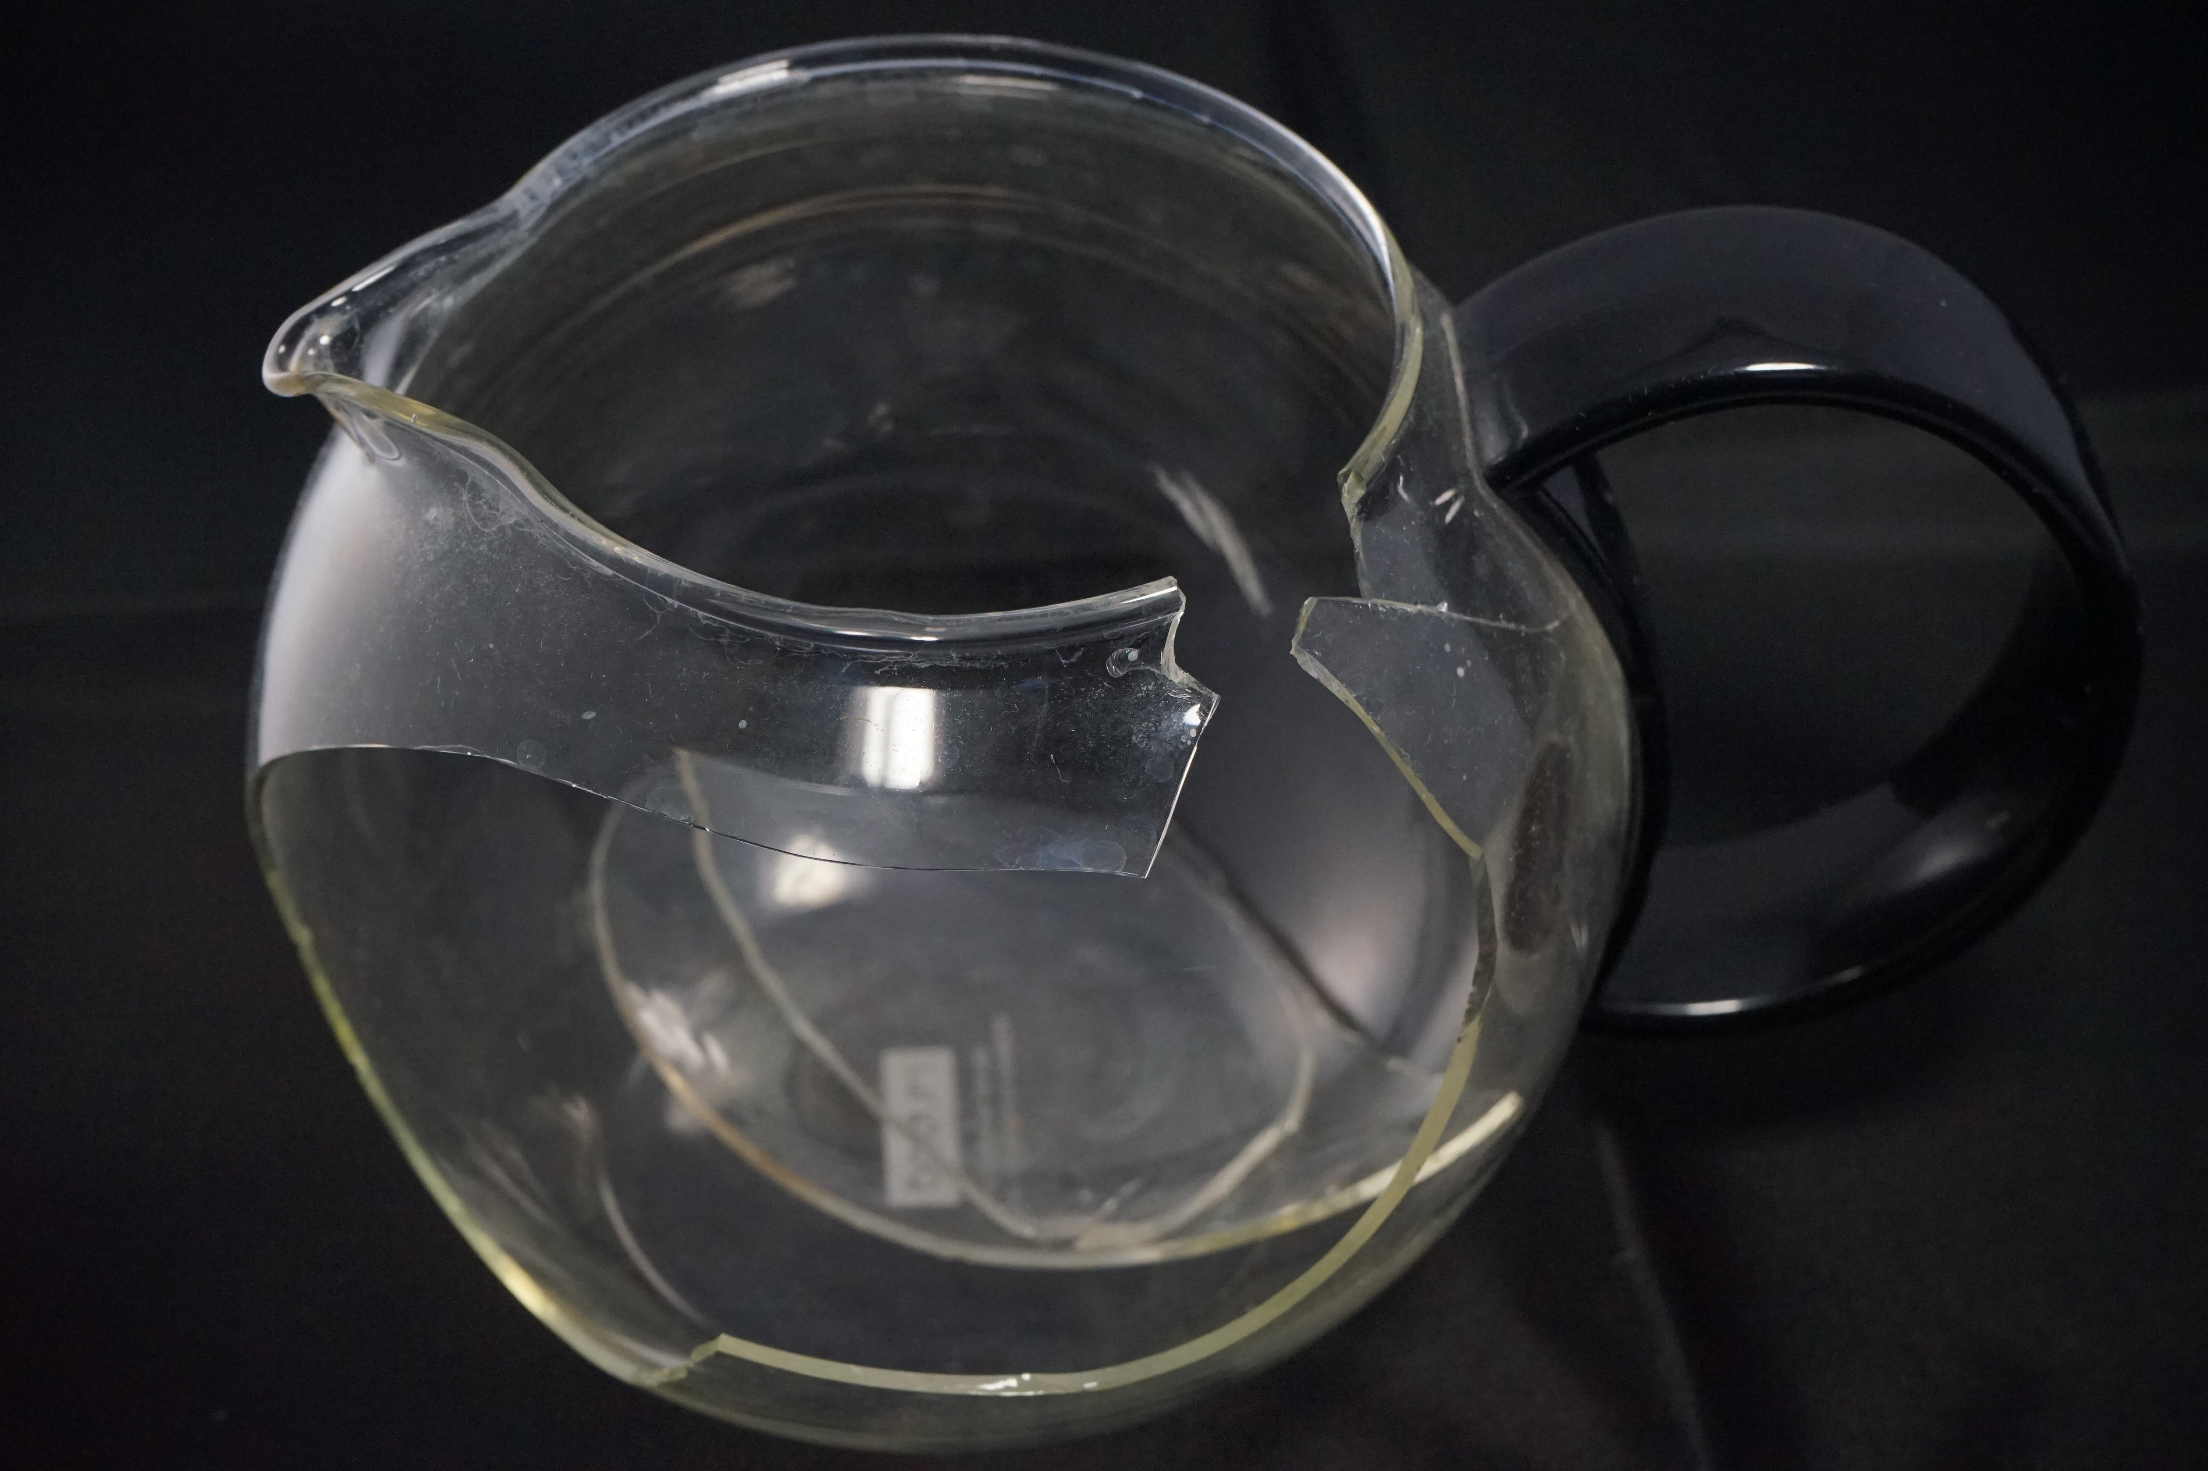
Borked
Broken entities call to mind what they ought to be able to do
They also interrupt any ongoing task with a new task to somehow recreate the missing capability
  Usually by fixing or replacing whatever broke
Image source

Slide 12
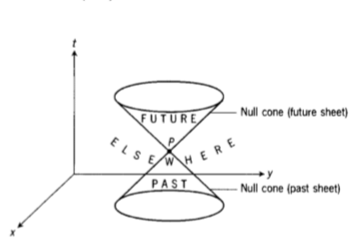
The ecstasies of time
Because these connections are always meant to accomplish something, we experience the future before the past.
The future is an imagined world based on the consequences of our projects and those we perceive around us.
The past is an imagined world that would have the present as its consequence
  We use the kinds of causality that create the future to reconstruct the past.
The present is the feeling of being thrown through time, caught between the infinite possibilities of future and past.
Image source

Slide 13
The ecstasies of time
Another fun exercise: try to identify the moment of “now.”
Anticipate when “now” is going to happen, then tap your finger or say “now” to yourself or whatever else feels right.
I can’t do it. I’m always just a bit too early or a bit too late.
Image source

Slide 14
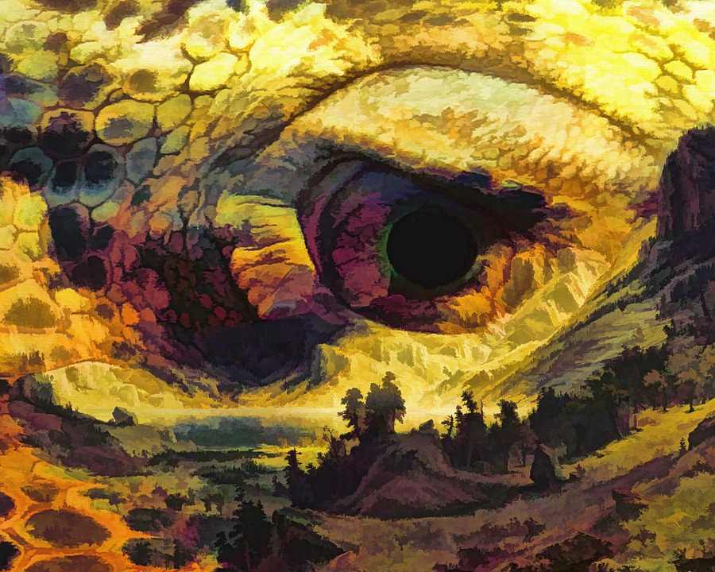
Imagination comes first
Perception comes from imagination, not the other way around.
This is one part of the magic of childhood that’s lost through maturity:
  Using one’s senses is a learning process that takes years. Imagination is innate from birth.
  Consciousness among children is much more self-referential. It’s less disciplined and thus freer.
  Most adults have learned to make perception their primary mode of imagination.
Image source

Slide 15
Thought and emotion are the same thing
Both of them are the imagination drawing logical connections between entities in the world

Slide 16

Emotions have logical structure
We experience fear when
  Some entity approaches
  That may or may not negatively affect or involve itself with
  Something we care about.
By threatening what matters to us, it also threatens us. It brings to mind our relationship to and our involvement with the entity that matters to us.
  It brings our cares to mind.
Our relationships and involvements create texture for every emotional encounter, and so does the nature of the things we encounter.
Image source

Slide 17

Math and hard sciences
Most of the time, we can’t perceive the kind of existence that math and ‘hard’ sciences attempt to describe.
  We can’t perceive them because imagination keeps primacy.
However, sometimes things happen in that world that we can perceive that go against average, everyday connection-making.
  We experience those things as ‘shock.’
Eugene Thacker has names for this:
  The World is average, everyday experience.
  The Earth is indifferent, thoughtless, and meaningless.
  The Planet is the fluid border between.

Slide 18
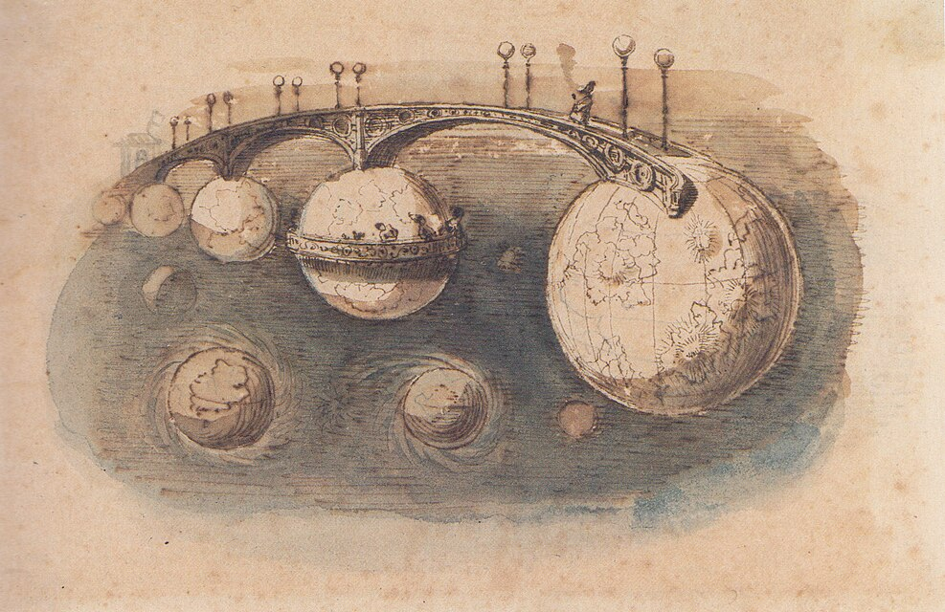
The edge of the World
In the World, everything connects to everything else through care.
  Creating, revealing, and activating possibilities, meanings, and projects.
Entities’ essences are concentrations of meaning and possibility embedded in them.
  Essence is condensed “doing.”
Limits to thought:
  “Thinkabilility” is reserved for entities that can be embedded in care networks.
  Anything that can’t is unthinkable.
Image source

Slide 19
That’s it for phenomenology
The “inside-out” approach to feeling

Slide 20
Now for
“affect theory”
Outside-in

Slide 21
Two emotional experiences to understand:
Shared
Individual
The shared aesthetic experience of a crowd at a good concert.
The individual experience of being the only person nearby who’s thrown off by the band’s racist lyrics.
Both kinds of experience are going to be affected by personal and shared histories.
  Repeated experiences will still feel different because of added life context.

Slide 22

How emotions (“affects”) flow
“[Given] that shared feelings are not about feeling the same feeling, or feeling-in-common, … it is the objects of emotion that circulate rather than emotion as such. … Such objects become sticky, or saturated with affect, as sites of personal and social tension.”
Simpler version:
  History gets baked into entities, and that history has an emotional valence.
  We don’t necessarily feel that valence, but we do feel something about it.

Slide 23
Pass it around
Emotion-laden entities flow between people in a social setting, and affect us before we reflect on them.
  The flow of these entities is called “affective flow.”
  “Affect” is our encounters with affective flow.
  The whole thing happens all at once: it’s simultaneous & ongoing, not sequential.
  Most “affect theory” studies specifics of these flows and encounters.
People’s emotions are also emotion-laden entities: we sense the things people around us feel.
  We don’t necessarily respond in the same way, but we do react to it.
Again, if you practice this enough, you start to perceive it.
  You’ll receive more praise for your attentiveness.

Slide 24
So, how does this help with fiction?

Slide 25
We are what we care about
By caring about a character in a story, we care about the things they care about, and what’s important to them becomes important to us.
For characters to feel ‘real,’ they have to care about things that are important, and other characters have to care about them in important ways.
  Don’t just “save the cat”: likeability is irrelevant. Show the character as a node in a network of relations and importance.
Lead with context.
  Create networks of care, comfort, meaning, and utility in the story.
  If we work on the context that creates care, we can make readers care more.
  If we express how each element of the story matters and affects each other element, we can make the books feel more cohesive.
  Increase characterization through the perspective character’s sensorium.
  Use the pathetic fallacy: when people are in a mood, the World reflects it.

Slide 26
Let the structure of emotion guide the plot
Putting the structures of emotions into the sequence of the story will help the readers feel things along with the characters.
We also need to understand the meaning-work that the story will do in the world once it gets published.
  How do these emotions get used?
  Where else do we see the patterns and arrangements in this book?
We need to at least be able to flag these issues for a possible sensitivity read.
I’m primarily a horror editor, so I need to understand the structures of fear, shock, disgust, pain, hate, shame, love, and trauma.
  Fear requires the fearsome entity, the threatened entity, and the fearer’s care.
  Fear-making in a story needs to happen before the fear happens:
    Establish a network of care.
    Establish what is being threatened.
    Establish the nature of the threat.
  The reader should then perceive those relationships and make their own fear.

Slide 27
Growth comes from meaning
Each time characters do something, it contributes to their skills and histories.
The meaning they garner from each choice or recontextualization is their growth arc.
We can also place elements elsewhere in the story that reflect the character’s choices (and the meaning they derive from those choices) to increase thematic resonance and character-plot cohesion.
We can also do this on the small scale with dialog:
Each speech act is a new choice for each character to make, so each conversation should change at least one participant, even if only by entrenching them.

Slide 28
Intimacy is a kind of growth
The more we care about someone, the more their cares become our cares, and the more we incorporate their personhood into our own.
This happens by involving ourselves in their projects.
  In other words, by doing stuff together.
True intimacy is also a threat to our sense of independence and self-determination.
  This is a reasonable fear: intimacy changes us.
By understanding intimacy-growth, we can better develop it on the page.
Based on that fear, people often pull away to re-assert their independence and self-determination.
  Sometimes, this is followed by a return to the mingling and alignment of cares.
Intimacy has more types than “romantic” and “sexual.”
  Friendly
  Familial
  Mentoring
  Collaborative
  Competitive
  Hostile
  Others, too

Slide 29
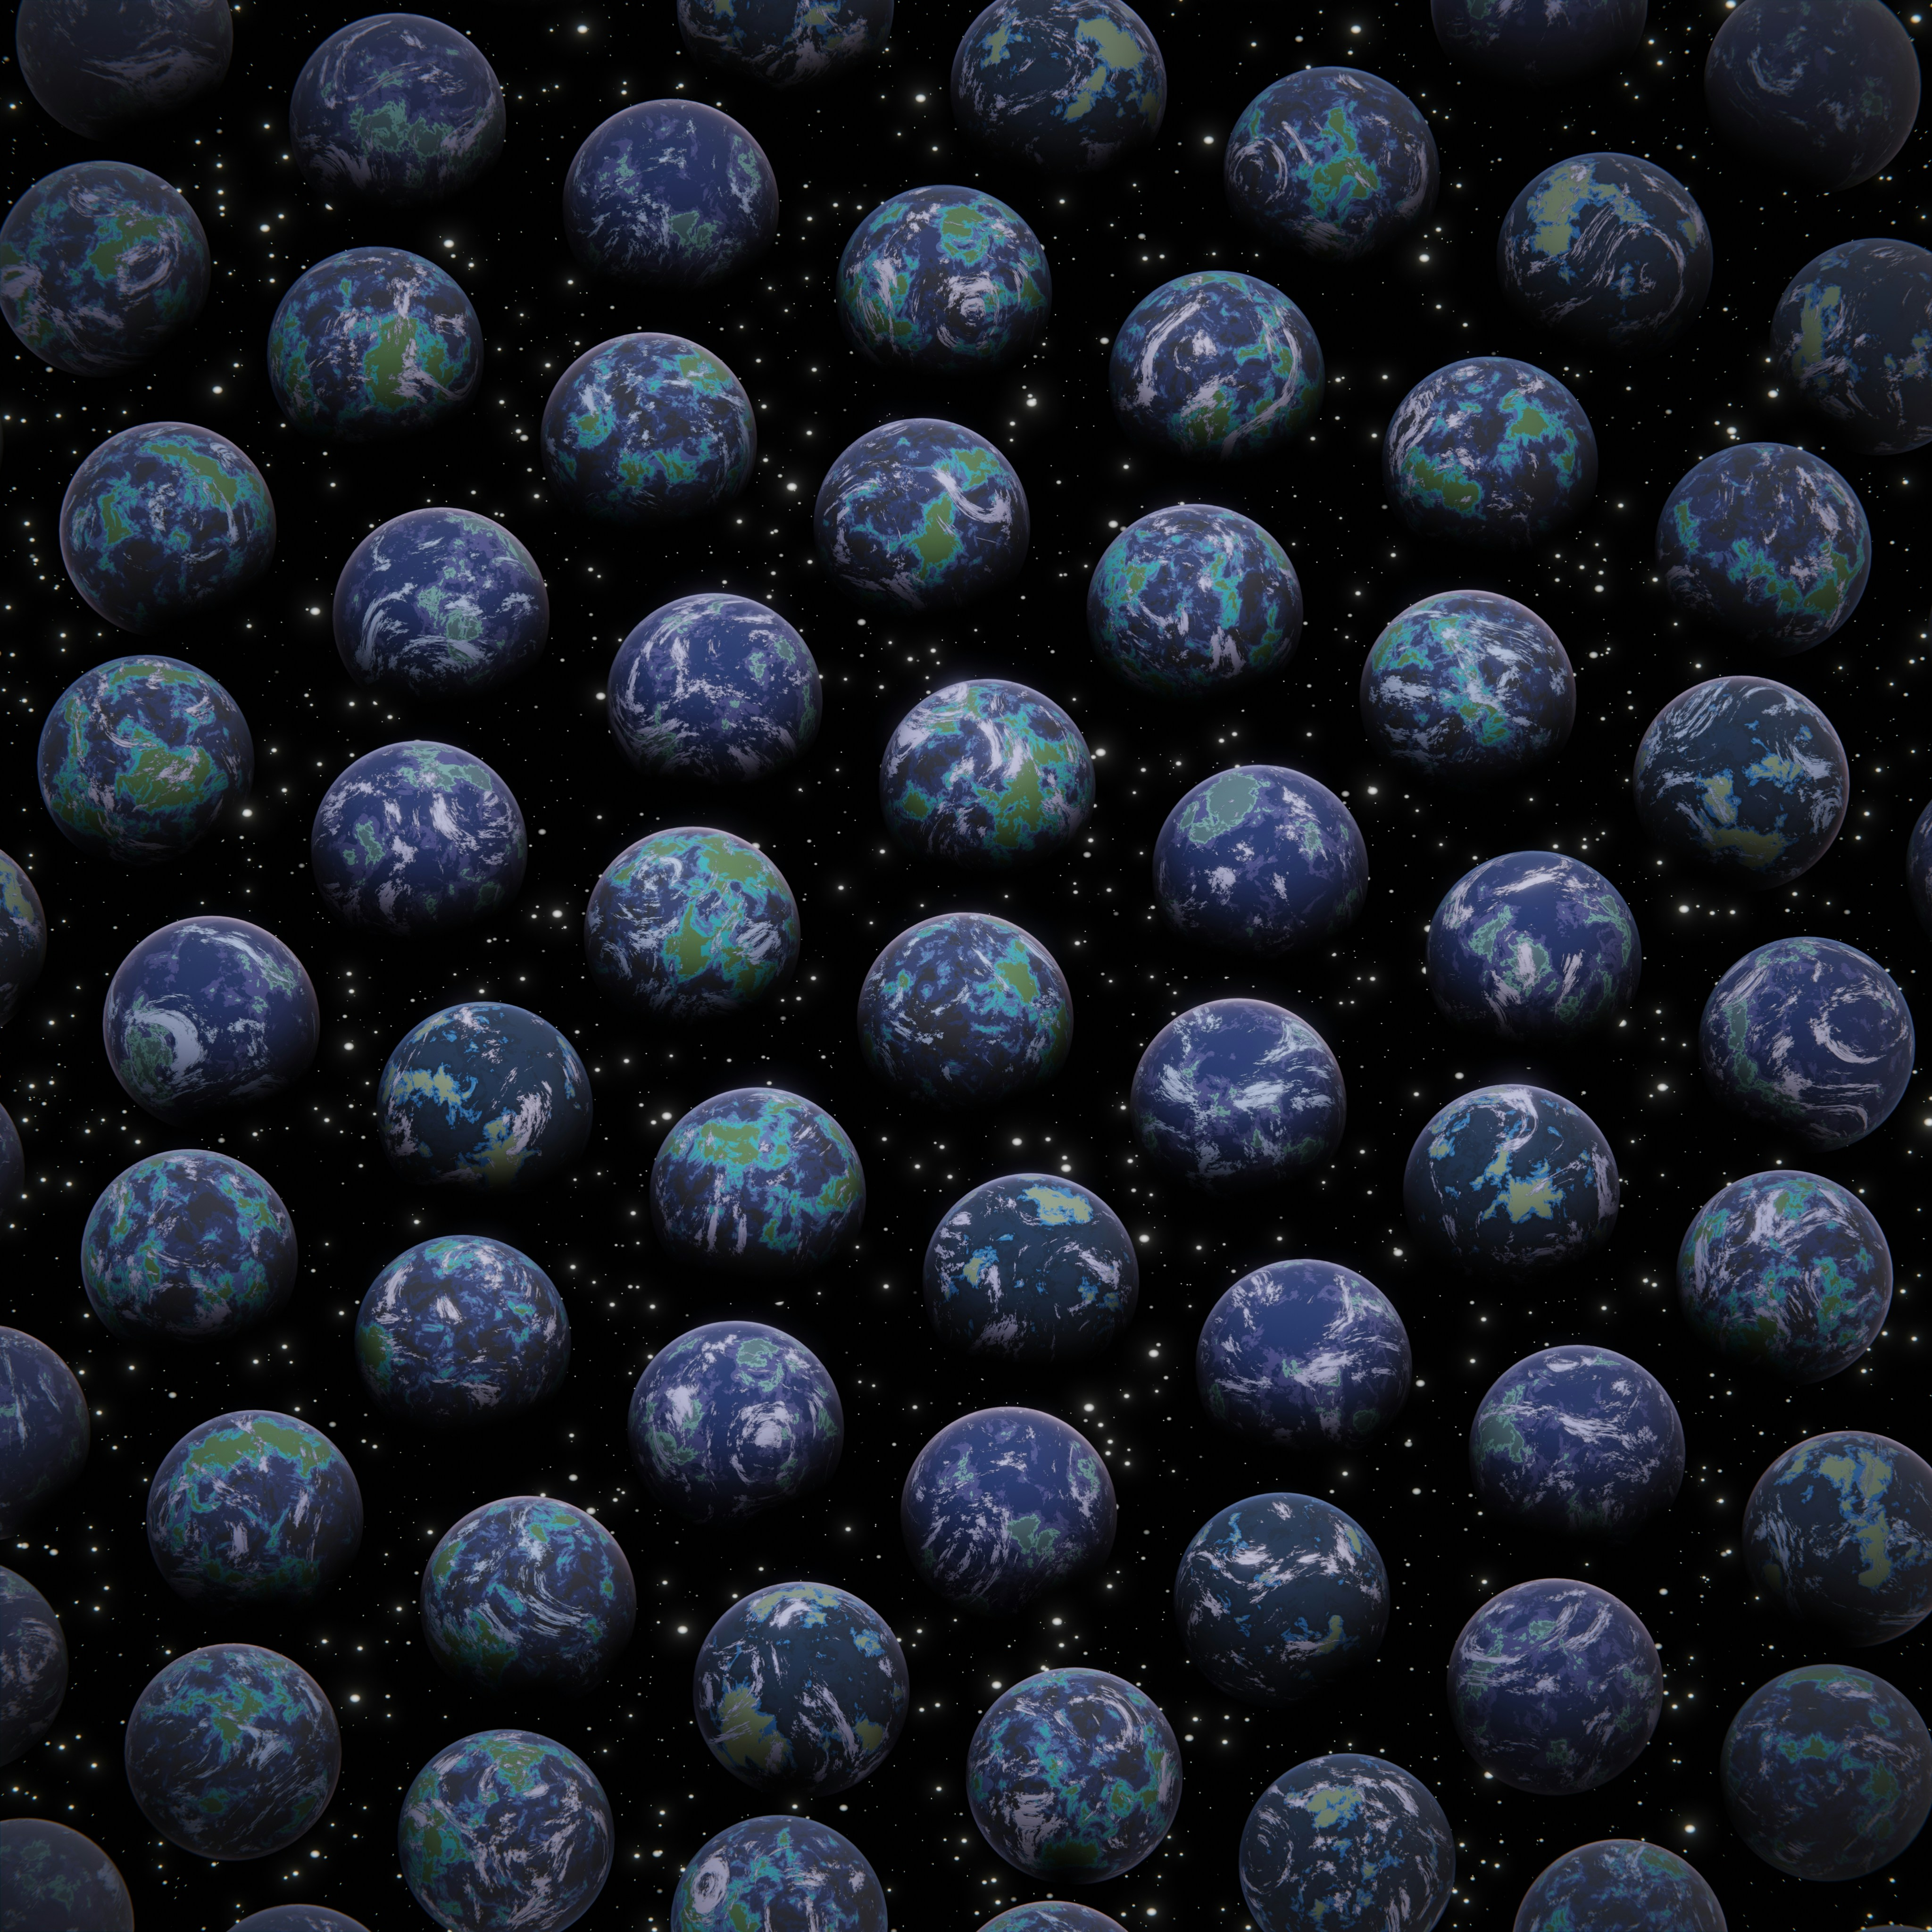
Worldbuild by doing stuff
Because “doing” is the basis of experience, we can streamline the worldbuilding we need to do:
  Present it in the context of choices.
  Incorporating worldbuilding into choices keeps the narrative moving and makes the tasks more interesting.
  Many readers can extrapolate from minor details, so heavy exposition is often unnecessary.
Image source

Slide 30
Worldbuild by doing stuff
Focusing on context and on doing stuff also helps to focus on:
  Bodily limitations, exchanges, and actions.
  Physical beats.
  How people act around each other.
It also increases perceived emotional and social realism.
  That, itself, also helps with reader immersion.
Image source

Slide 31
Questions? Clarifications? Comments?
You can also contact me after this session. I’m Snazzerdoo on Discord, and my email address is molly@horroreditor.com.

Slide 32

Thanks for attending!
Further readings
Phenomenology:
  Philosophical Investigations, Being and Time (with a hefty critical eye, as well as a reading buddy or a teacher), Queer Phenomenology, this essay, this essay, and Phenomenology of Perception
Affect theory:
  The Affect Theory Reader, its new sequel The Affect Theory Reader 2, The Cultural Politics of Emotion, and The Affective Turn
Horror philosophy:
  In the Dust of This Planet, The Memory of Place, and my master’s thesis excerpt
My Revision 201 document
You can find me at horroreditor.com
Email: molly@horroreditor.com
Discord: Snazzerdoo
Tumblr: bramblegeist

